Slide 1

MicroHydroV1 — R&D Progress Overview
Advancing innovative micro-hydropower technology solutions
Notes:
AI-generated content may be incorrect. ---

Slide 2
Project Overview
Notes:
Objectives and Scope, Deliverables and Stages

Slide 3
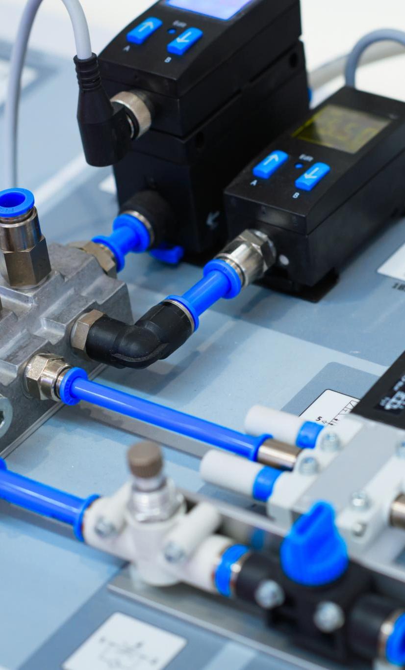
Objectives and Scope
Innovative Hydraulic Design
Focus on validating design improvements like hyperbolic tank inlet and pre-swirl nozzle for optimized energy generation.
Performance Testing and Stability
Conduct bench testing and performance analysis to reduce ripple effects and ensure system stability under varying conditions.
Scalable Renewable Energy Solution
Deliver a scalable, efficient micro-hydro solution for decentralized renewable energy using advanced computational heuristics.
Structured Workflows and Automation
Implement structured workflows and automated data handling to ensure traceability and precision engineering.
Notes:
MicroHydroV1 is an advanced micro-hydropower initiative focused on optimizing energy generation through innovative hydraulic design and rigorous testing. The primary objectives include validating design improvements such as the hyperbolic tank inlet and pre-swirl nozzle, reducing ripple effects in the tank, and ensuring system stability under varying operational conditions. The scope encompasses design iterations, bench testing, and performance analysis to meet stringent acceptance criteria. This project aims to deliver a scalable, efficient solution for decentralized renewable energy, leveraging conventional hydraulics principles combined with modern computational heuristics. Key deliverables include design documentation, test procedures, and a consolidated readout of findings, ensuring traceability from concept to implementation. By integrating structured workflows and automated data handling, MicroHydroV1 sets a benchmark for precision engineering in micro-hydro systems.

Slide 4
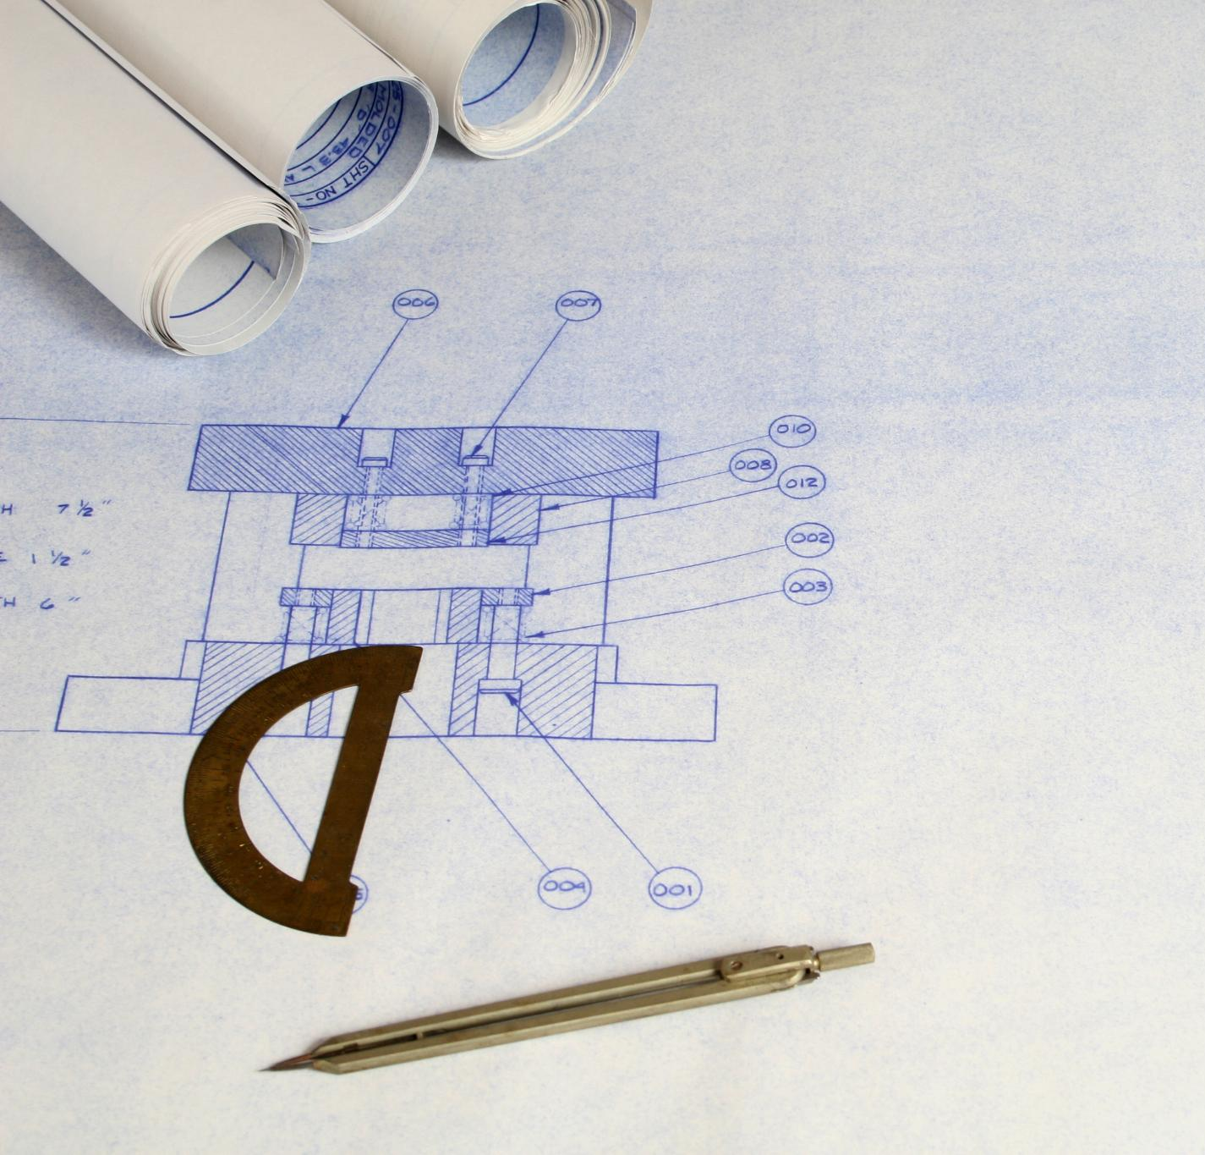
Deliverables and Stages
Stage A: Design Development
Focuses on design development with hyperbolic tank inlet and 9 mm pre-swirl nozzle to improve flow dynamics.
Stage B: Bench Testing
Includes Jet Coherence and Tank Ripple tests to validate hydraulic performance under controlled conditions.
Stage C: Analytical Evaluation
RUN-2 phi-weight comparisons across multiple factors provide insights into system behavior with different configurations.
Stage D: Design Matrix Consolidation
Findings are compiled into the STW Design Matrix, categorizing features by performance and stability.
Notes:
The project deliverables are organized into four major stages: Stage A focuses on design development, introducing the hyperbolic tank inlet and 9 mm pre-swirl nozzle to enhance flow dynamics. Stage B involves bench testing, including Jet Coherence and Tank Ripple tests, to validate hydraulic performance under controlled conditions. Stage C centers on analytical evaluation, specifically RUN-2 phi-weight comparisons across multiple weighting factors (0.1, 0.5, 1.0), providing insights into system behavior under different configurations. Stage D consolidates findings into the STW Design Matrix, categorizing features as Admit or Hold based on performance and stability. Each stage produces structured outputs such as engineering reports, test procedures, and data intake templates, ensuring comprehensive documentation and alignment with acceptance criteria. This phased approach guarantees systematic progress and informed decision-making throughout the R&D cycle.

Slide 5
Acceptance Criteria and Key Decisions
Notes:
Performance Benchmarks, Admit vs Hold Items

Slide 6
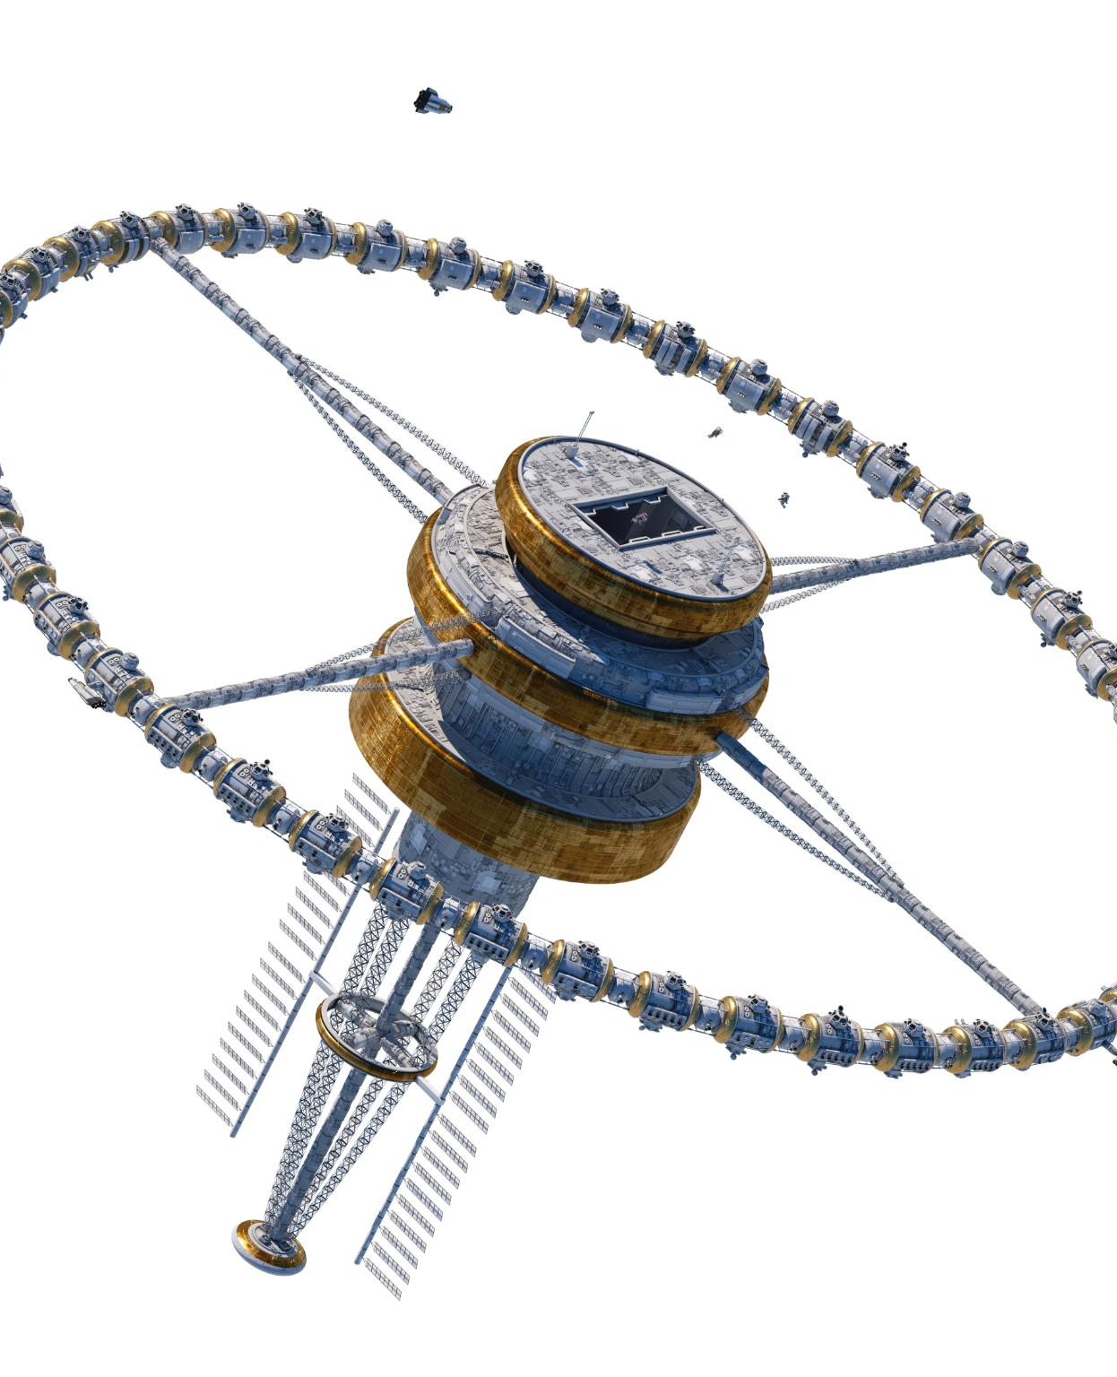
Performance Benchmarks
Jet Coherence Benchmark
Jet coherence must reach at least 0.90 to ensure jet stability and minimal dispersion in the system.
Tank Ripple Reduction
Tank ripple should be reduced by 30% to 50% compared to straight inlet, without increasing entrainment.
Electrical Load Control Stability
ELC drift must stay within ±0.1 Hz to avoid hunting and maintain operational stability.
Notes:
MicroHydroV1 adheres to strict acceptance criteria to ensure reliability and efficiency. For Jet Coherence (T-001), the benchmark is a coherence value of at least 0.90, indicating optimal jet stability and minimal dispersion. For Tank Ripple (T-002), the target is a ripple amplitude reduction between 30% and 50% compared to a straight inlet, with no increase in entrainment. Additionally, electrical load control (ELC) drift must remain within ±0.1 Hz to prevent hunting and maintain operational stability. These criteria are derived from industry standards and tailored to the unique requirements of micro-hydro systems. Meeting these thresholds confirms the viability of design enhancements and informs subsequent scaling decisions. Failure to meet any criterion triggers iterative design adjustments or alternative strategies, reinforcing a data-driven approach to system optimization.

Slide 7
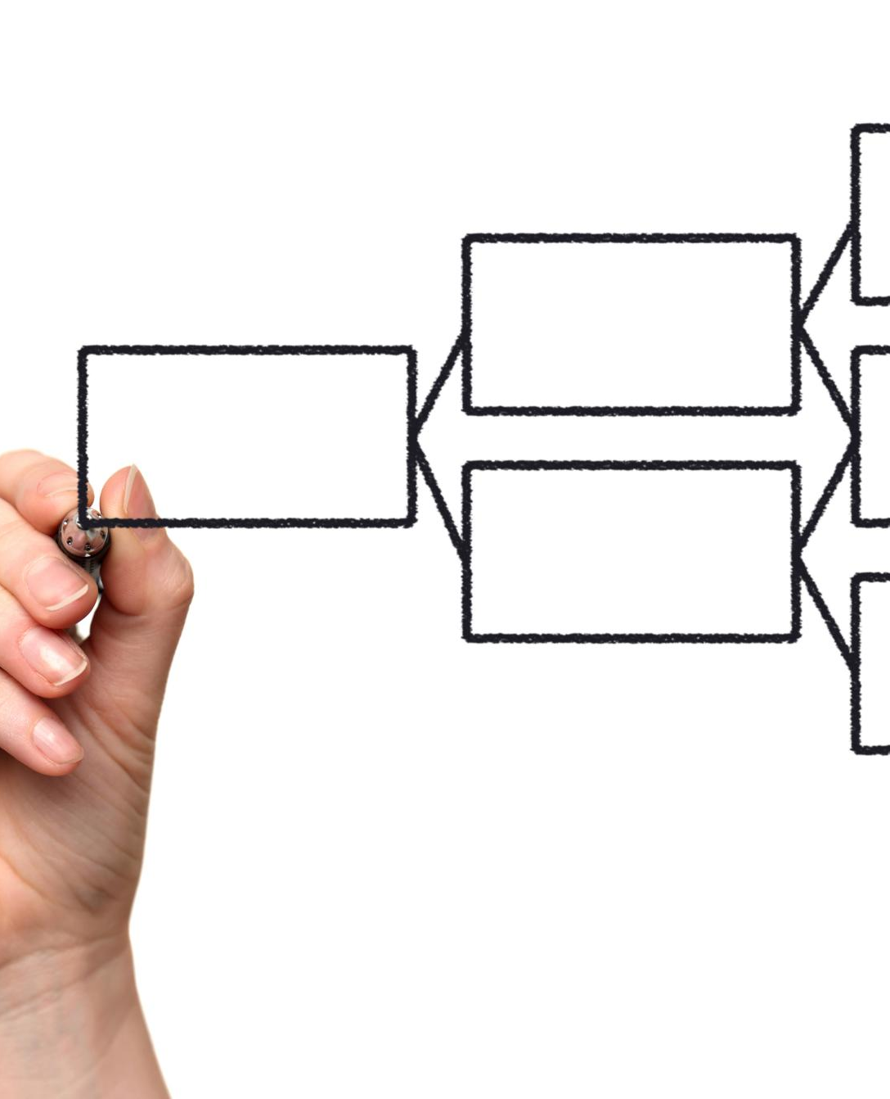
Admit vs Hold Items
Admit Items Overview
Admit items improve performance and include components like hyperbolic tank inlet and 9 mm nozzle with pre-swirl insert.
Hold Items Overview
Hold items require further stability improvements, such as phi-segmented penstocks and Hydram phi-timing under certain conditions.
Framework Benefits
The design matrix reduces risk and optimizes resource allocation by advancing only proven features to implementation.
Notes:
The STW Design Matrix classifies components into Admit and Hold categories based on empirical results and stability analysis. Admit items include the hyperbolic tank inlet, which improves flow uniformity; the 9 mm nozzle with pre-swirl insert, enhancing jet coherence; the DN125 penstock baseline with a clear path for DN150 scaling; and the conventional narrow ELC window for maintaining frequency stability. Hold items encompass phi-segmented penstocks, phi-ELC windows pending stability improvements, and Hydram phi-timing unless flow exceeds a 5% threshold. This structured decision framework ensures that only proven features advance to implementation, reducing risk and optimizing resource allocation. By documenting rationale and dependencies, the matrix supports transparent governance and facilitates stakeholder confidence in the development process.

Slide 8
Bench Testing and Data Workflow
Notes:
Jet Coherence Test (T-001), Tank Ripple Test (T-002)

Slide 9

Jet Coherence Test (T-001)
Test Purpose and Setup
The test evaluates water jet stability using imaging with calibrated targets and controlled lighting conditions.
Data Capture and Analysis
Multiple frames are recorded and analyzed with algorithms to compute coherence metrics for jet uniformity.
Performance Validation and Optimization
Results guide nozzle design validation and pre-swirl adjustments to optimize jet performance and stability.
Data Integration and Visualization
Test data integrates with templates and dashboards for real-time updates, trend tracking, and traceability.
Notes:
The Jet Coherence Test evaluates the stability and uniformity of the water jet under operational conditions. Utilizing an imaging setup with calibrated targets and controlled lighting, the test captures high-resolution sequences for coherence analysis. The procedure involves stabilizing flow at the target head, recording multiple frames, and computing coherence metrics using predefined algorithms. Data is logged in structured templates, enabling automated pass/fail evaluation against the ≥0.90 criterion. This test not only validates nozzle design but also informs adjustments to pre-swirl configurations for enhanced performance. Integration with the Results Intake Template and RnD workbook ensures seamless data handling, real-time dashboard updates, and trend visualization, supporting iterative optimization and comprehensive traceability.

Slide 10

Tank Ripple Test (T-002)
Measuring Surface Oscillations
The test measures ripple amplitude to evaluate hydraulic stability improvements from the hyperbolic inlet design.
Baseline and Acceptance Criteria
Baseline data from a straight inlet sets references; acceptance requires 30%-50% ripple reduction without extra entrainment.
Data Processing and Visualization
Structured intake sheets enable automated analysis and dashboards visualize ripple trends against baseline values.
Design Feedback and Refinement
Test results provide critical insights for flow conditioning and support rapid iterative design improvements.
Notes:
The Tank Ripple Test measures surface oscillations to confirm hydraulic stability improvements introduced by the hyperbolic inlet. Using a pressure transducer (PT) and data acquisition system, the test records ripple amplitude under controlled flow conditions. Baseline measurements with a straight inlet establish reference values for comparison. The acceptance threshold requires a reduction of 30% to 50% in ripple amplitude without increasing entrainment. Data is processed through structured intake sheets, enabling automated evaluation and visualization of ripple trends against baseline values. This test provides critical insights into flow conditioning effectiveness and informs design refinements. Coupled with dashboard analytics and trend charts, the workflow ensures rapid feedback and decision-making for subsequent iterations.

Slide 11
Analytical Evaluation and RUN-2 Insights
Notes:
Phi-Weighting Comparison

Slide 12
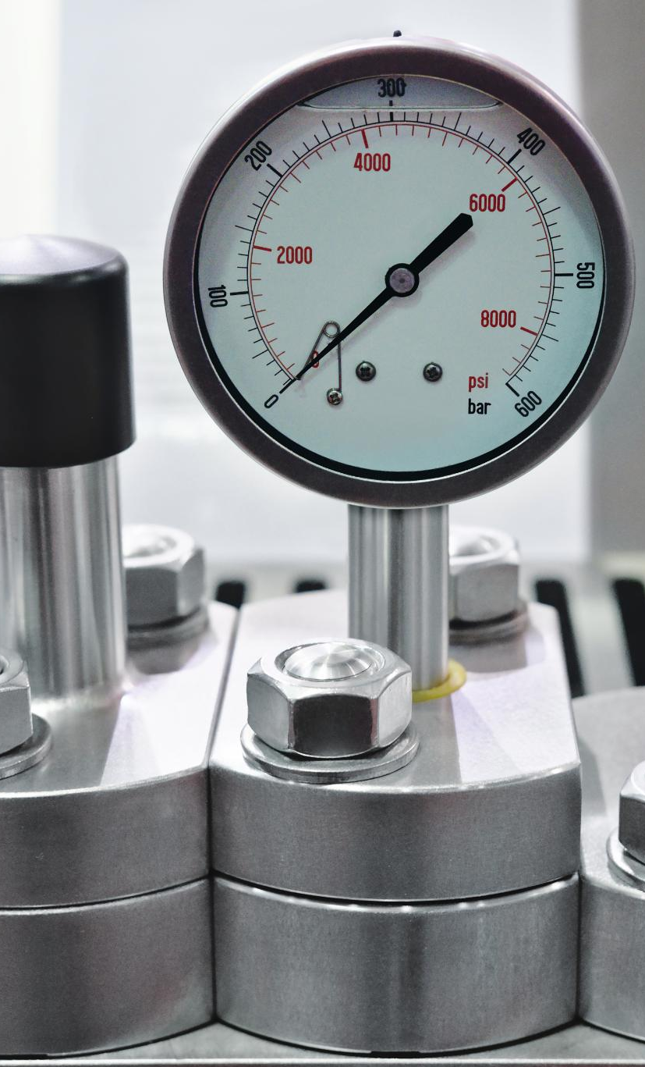
Phi-Weighting Comparison
Phi-Weighting Factor Analysis
Analysis of phi-weighting factors evaluates system sensitivity and performance variations under different configurations.
Performance Metrics Comparison
RUN-2 examines hydraulic efficiency, stability margins, and energy output at phi-weighting values 0.1, 0.5, and 1.0.
Optimal Weighting Insights
Intermediate phi-weighting balances coherence and ripple suppression, avoiding compromises in stability or efficiency.
Data-Driven Design Decisions
Structured reporting and visual analytics guide Admit/Hold decisions, supporting robust system optimization and scaling.
Notes:
Stage C introduces a comparative analysis of phi-weighting factors to assess system sensitivity and performance under varying configurations. RUN-2 evaluates weighting scenarios at wφ values of 0.1, 0.5, and 1.0, generating a comprehensive dataset on hydraulic efficiency, stability margins, and energy output. Findings indicate that intermediate weighting offers a balanced trade-off between coherence and ripple suppression, while extreme values may compromise stability or efficiency. These insights guide parameter tuning and inform the Admit/Hold decisions documented in the STW Design Matrix. By leveraging structured reporting and visual analytics, the evaluation ensures that design choices are grounded in empirical evidence, supporting robust optimization strategies for future scaling.

Slide 13
Next Steps and Risk Management
Notes:
Implementation Roadmap, Risk Register and Mitigation Strategies

Slide 14

Implementation Roadmap
Immediate Next Steps
Execute test campaigns, import measurement data, and refine documentation for stakeholder review.
Priority Actions
Complete key tests T-001 and T-002, validate results, and update dashboards for real-time tracking.
Long-Term Objectives
Scale validated designs, integrate advanced control strategies, and prepare stakeholder presentations.
Notes:
The immediate next steps involve executing the Test Campaign Plan, importing real measurement data into the RnD workbook, and refining documentation for stakeholder review. Priority actions include completing T-001 and T-002 tests, validating results against acceptance criteria, and updating dashboards for real-time performance tracking. Concurrently, refinement prompts will be applied to enhance technical clarity and consistency across all deliverables. Longer-term objectives encompass scaling validated designs, integrating advanced control strategies, and preparing a stakeholder presentation highlighting key achievements and future opportunities. This roadmap ensures structured progression from R&D to implementation, minimizing risk and maximizing impact.

Slide 15

Risk Register and Mitigation Strategies
Imaging Variability Risks
Imaging variability affects coherence measurements and is mitigated through controlled lighting and calibration frames.
Sensor Noise Mitigation
Sensor noise in ripple detection is reduced by signal filtering and performing repeated measurement runs.
ELC Drift Management
ELC drift under dynamic loads is managed via narrow window tuning and stability checks to ensure accuracy.
Resource and Environmental Risks
Resource constraints and environmental variability are addressed through contingency planning and adaptive scheduling.
Notes:
Key risks identified include imaging variability affecting coherence measurements, mitigated through controlled lighting and calibration frames; sensor noise in ripple detection, addressed via signal filtering and repeated runs; and ELC drift under dynamic loads, managed through narrow window tuning and stability checks. Additional risks involve resource constraints and environmental variability, requiring contingency planning and adaptive scheduling. Each risk is documented with likelihood, impact, and mitigation strategies in the risk register, ensuring proactive management and stakeholder confidence. By embedding risk governance into the workflow, MicroHydroV1 maintains resilience and adaptability throughout the development lifecycle.

